Slide 1




Prediction Error and Memory:
Insights from computational models
Francesco Pupillo, Javier Ortiz-Tudela, Rasmus Bruckner, Yee Lee Shing
FLUX 2021

Slide 2
Introduction
Priors
Prior
updating
Better recognized when schema-congruent (e.g., Bein et al., 2015; Brod & Shing, 2019; Craik and Tulving, 1975)
Matched
Violated:
PE
Memory for the events?
Better recognized when schema-incongruent (e.g., Greve et al., 2017, Kafkas & Montaldi, 2018)

Slide 3


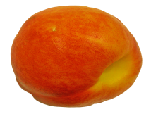



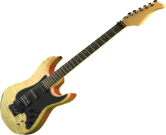

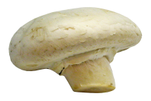
Methods
Prediction Task
Reinforcement learning
model
?
Strong
prior
contexts
?
Flat
prior
contexts
r_{t} = 1 , 0
Surprise recognition test
Have you seen this object before?

Slide 4
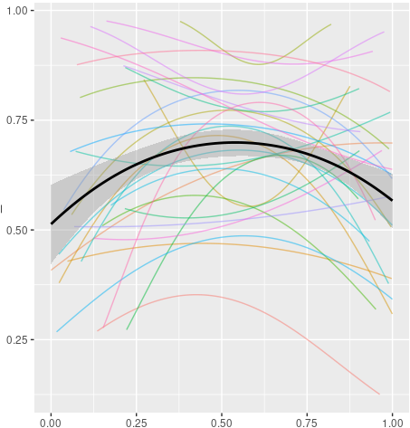
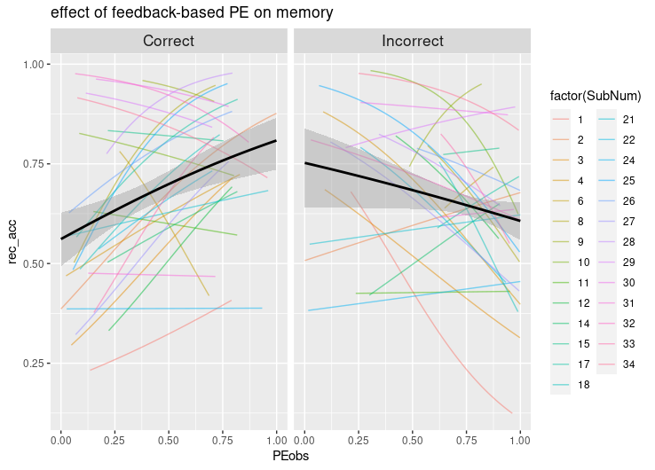
Results
Across trials
Prediction
Memory Accuracy
(Probability)
Memory Accuracy
(Probability)
PE
PE
Quadratic effect: β = - 6.43, p = .006
Interaction: β = -1.94, p = .001

Slide 5
Conclusions
Important moderating role of prediction outcome and of considering PE in relation to the task participants are doing.
Results are in line with with studies finding worse memory for unexpected events (Bein et al., 2015; van Kesteren et al., 2013), and with studies finding on reward PE showing enhanced memory for better than expected outcomes (De Loof et al., 2017; Jang et al., 2019).
Strong prediction error in the context of positive feedback might indicate the utility of that item for future predictions.
Strong prediction error in the context of negative feedback in a task where contingencies are stable may signal participants that that choice is not informative.
OUTLOOK: Relationship between PE and memory in children.

